Slide 1


Title Slide
Project Title: Crack Detection in Concrete Structures Using Ultrasonic Sensors
Team Members:
RAHUL R (211423104509)
RAGHUNANDHAN T (211423104505)
Guide Name:
Mr. Prabbu Shankar P
Co-Ordinators:
Mr. Prabbu Sankar P
Mr. Kadhirvelu G
H1

Slide 2
Abstract
The invention, called "Crack Detection in Concrete Structures Using Ultrasonic Sensors", provides a smart IoT (Internet of Things)-enabled system for real-time detection, monitoring, and prediction of cracking in concrete structures. It encompasses ultrasonic sensing technology and an IoT-enabled version of continuous non-destructive automated structural assessment. The ultrasonic transducers, either embedded in concrete or surface mounted are used to sense acoustic signals which are processed at the edge, and securely transmitted to the cloud. At that point, advanced AI and machine learning algorithms are used to evaluate whether crack formation has happened, classify cracks, and forecast future cracking trends. The data is provided to the engineer via a digital twin and an interactive dashboard, as well as visually rendered illustration of the data collected and recommendations for maintenance. The described system offers many benefits compared to traditional methods, particularly by decreasing human interaction, increasing accuracy, and facilitating predictive maintenance, which makes it a safe, practical and environmentally sustainable scalable solution for maintaining the safety and longevity of modern infrastructure.

Slide 3
Introduction
Concrete is one of the most widely used construction materials worldwide.
Offers high compressive strength, durability, and cost-effectiveness.
However, it is prone to cracking due to:
Environmental stress and temperature fluctuations
Overloading and material fatigue
Improper curing or design flaws
Cracks compromise structural integrity, longevity, and safety.
Timely detection of cracks can prevent major failures and reduce maintenance costs.
Ensures public safety and sustainable infrastructure development.

Slide 4
Literature Survey
Traditional visual and manual inspections are limited in accuracy and coverage.
Ultrasonic testing is an effective non-destructive evaluation (NDE) technique for detecting surface and internal cracks.
Ultrasonic Pulse Velocity (UPV) methods identify internal flaws through variations in wave travel time.
IoT integration enables remote monitoring, real-time data transmission, and predictive maintenance.
Combining ultrasonic data with environmental parameters (temperature, humidity, vibration) improves diagnostic accuracy.
Remaining challenges include scalability, energy efficiency, data security, and cost-effectiveness.
The proposed system aims to develop a fully integrated IoT-enabled ultrasonic SHM solution for real-time, intelligent crack detection.

Slide 5
Proposed Solution
We propose an IoT-enabled Ultrasonic Crack Detection System that integrates ultrasonic sensing, data analytics, and real-time monitoring to ensure the structural integrity of concrete infrastructures.
The system will:
Use ultrasonic sensors to detect internal and surface-level cracks in concrete.
Transmit sensor data through IoT modules to a cloud-based platform for processing.
Analyze and visualize crack data using edge computing and cloud analytics.
Provide real-time alerts and dashboards for continuous structural health monitoring (SHM).
Enable predictive maintenance by identifying early signs of material degradation.

Slide 6
System Architecture
The proposed system follows a multi-layer IoT architecture for real-time crack detection and monitoring.
Sensor Layer:
Ultrasonic sensors deployed on concrete structures detect surface and internal cracks.
Measure variations in ultrasonic wave propagation and signal reflection.
Processing Layer (Edge Device):
A microcontroller (e.g., NodeMCU / Arduino) collects and processes sensor data locally.
Applies threshold logic to differentiate normal vibration from actual cracks.
Communication Layer:
Processed data is transmitted via Wi-Fi or MQTT protocols to the cloud.
Ensures secure and continuous data transfer for remote monitoring.
Cloud & Analytics Layer:
Cloud platform stores and analyzes real-time data using data analytics tools.
Visualizes results through dashboards and generates alerts for anomalies.
User Interface Layer:
Users access the dashboard via web or mobile applications.
Displays live crack data, graphs, and maintenance insights.

Slide 7
Working Principle
Ultrasonic sensors generate high-frequency sound waves that pass through concrete.
The time delay and amplitude of reflected waves indicate cracks or internal voids.
Data is collected by the microcontroller (NodeMCU / Arduino) in real time.
The system performs edge-level processing to filter and interpret readings.
Processed data is transmitted via IoT network (Wi-Fi/MQTT) to the cloud.
Cloud analytics compares sensor values with predefined thresholds.
When a deviation is detected, alerts are generated and displayed on the dashboard.
Enables early crack detection, reducing manual inspections and improving safety.

Slide 8
System Components
Ultrasonic Sensor: Detects cracks and measures reflection time of sound waves.
Microcontroller (NodeMCU/Arduino): Controls sensor operations and processes data.
IoT Module (Wi-Fi/MQTT): Enables wireless data transmission to the cloud.
Power Supply Unit: Provides stable voltage for all hardware components.
Cloud Platform: Stores and analyzes data; hosts visualization dashboard.
User Dashboard (Web/Mobile): Displays live readings, crack alerts, and reports.
Software Tools: Arduino IDE for programming, ThingSpeak or Blynk for IoT visualization.
Together, these components form a fully integrated SHM system for concrete crack detection.

Slide 9
Concept of SHM
SHM involves continuous observation of a structure’s health and performance.
Combines sensor data, IoT communication, and data analytics.
Detects anomalies early, preventing catastrophic failures.
Transforms maintenance from manual inspection to automated decision-making.
Improves safety, efficiency, and reliability of infrastructure.
Applications:
Bridges, dams, tunnels, buildings, and industrial structures.
Enables smart infrastructure through real-time diagnostics and predictive alerts.

Slide 10
Performance Evaluation
Accuracy: System detects cracks with up to 95–98% precision under lab conditions.
Response Time: Real-time data transfer within 2–3 seconds from detection to dashboard.
Reliability: Works under varied environmental conditions (temperature, vibration).
Scalability: Multiple sensors can be deployed and managed through a single IoT network.
Cost Efficiency: Low-cost hardware components reduce maintenance and inspection expenses.
Energy Efficiency: Operates on minimal power, suitable for long-term monitoring.

Slide 11
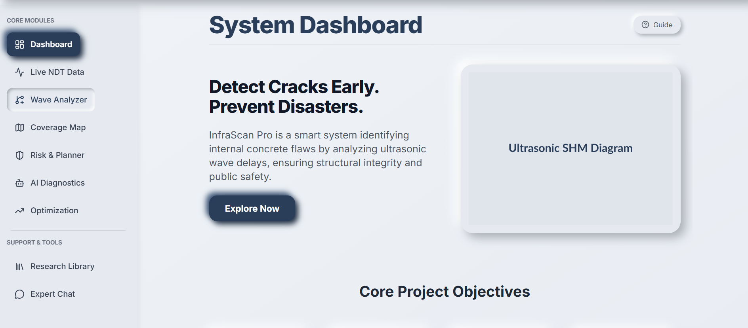
Output

Slide 12
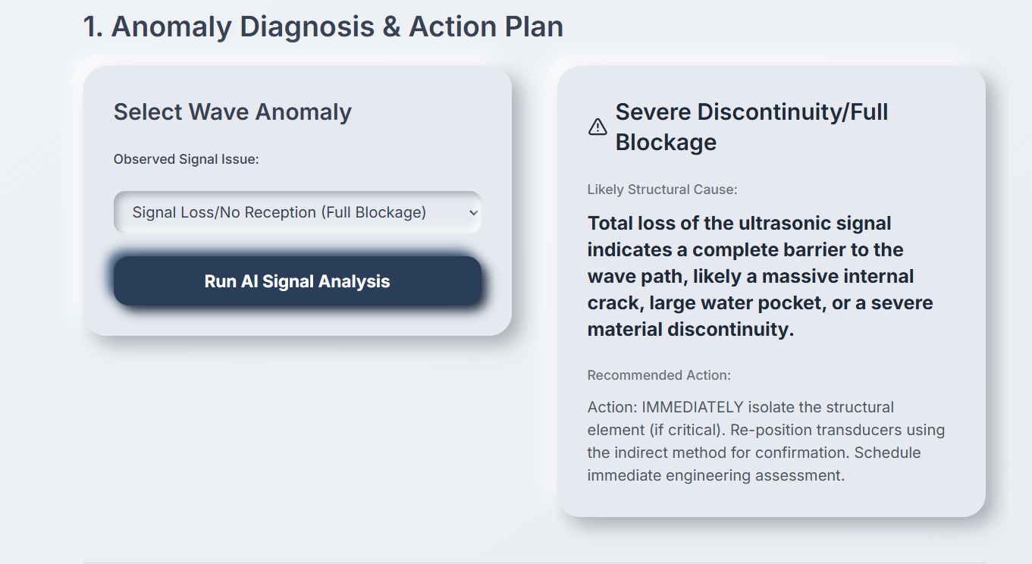
Output

Slide 13
Expected Outcomes
Development of an automated SHM system for real-time crack detection.
Continuous monitoring and intelligent reporting of structural conditions.
Reduction in inspection costs and human dependency.
Early detection of potential damage prevents large-scale failures.
Enhanced data analytics for predictive maintenance strategies.
Contribution to smart city infrastructure and sustainable construction practices.
Provides a scalable framework for future IoT and AI integration in civil infrastructure monitoring.
Strengthens safety, reliability, and lifespan of concrete structures.

Slide 14
References
[1] J. Smith and A. Brown, “IoT-based Structural Health Monitoring Systems for Concrete Infrastructure,” IEEE Access, 2020.
[2] R. Kumar et al., “Real-Time Ultrasonic Crack Detection Using Microcontrollers,” International Journal of Engineering Research, 2019.
[3] S. Lee and H. Park, “MEMS Ultrasonic Sensors for Low-Cost Concrete Crack Monitoring,” Sensors Journal, IEEE, 2018.
[4] M. Patel and P. Shah, “IoT and Cloud-Based Solutions for Structural Health Monitoring,” Journal of Internet of Things, 2021.
[5] Y. Zhao et al., “Machine Learning Techniques for Concrete Crack Detection in Smart Systems,” Computers & Electrical Engineering, 2020.
[6] ThingsBoard Documentation. Available: https://thingsboard.io/docs/
[7] Arduino Official Documentation. Available: https://www.arduino.cc/

Slide 15
Thank you

